Slide 1

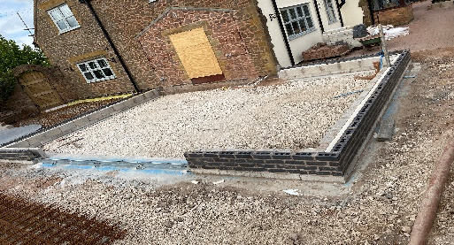
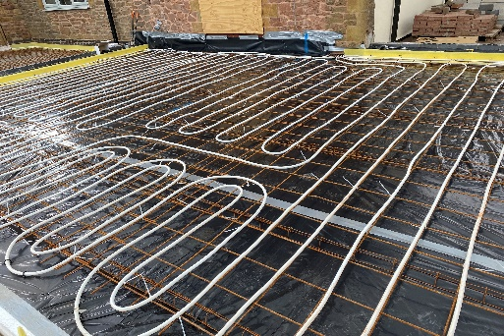
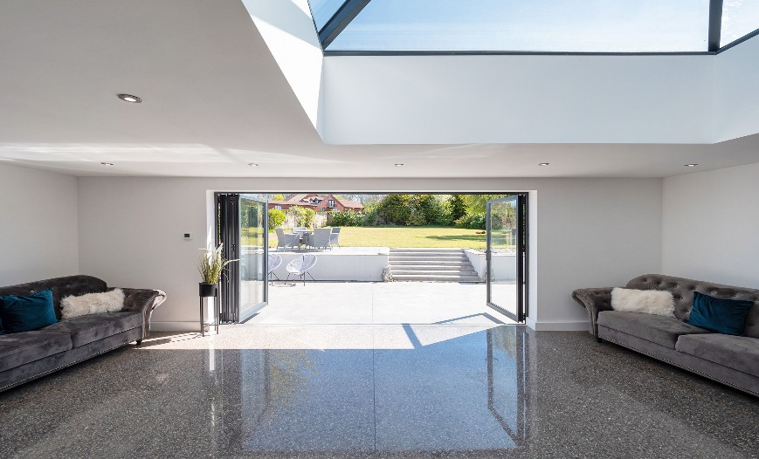
Case Study
Project Name: Yew Tree Cottage
Area: Circa 60m2
Timescales: 6 Days
Day 1 DPM & Insulation.
Day 2 UFH
Day 3 Concrete
Days 4-6 polishing
Products Installed: Membranes
Insulation
Under Floor Heating
Exposed Polished Concrete
Value Engineering: Midland Flooring installed 125mm Raven
grey exposed polished concrete, with
the underfloor heating system. To a new
extension removing the need for a base
slab and screed as the new polished
concrete was both the base and finished
floor.
Providing a modern, light-reflective, easy
to clean heat-efficient floor finish.

